Slide 1


Lecture 3 C++ Basics
PROGRAMMING 1
(CS 102)
3
Fall (2025-2026)

Slide 2
Course Learning Objectives
Explain and define fundamental programming concepts, including variables, data types, the sequential nature of program execution, and basic program input/output (I/O).
Trace and debug simple programs to identify and correct basic syntax and logical errors.
Apply basic programing concepts, such as conditional statements, loops, and functions, to solve small scale computational problems.
Decompose problems into smaller, manageable subroutines, and implement basic functions to enhance code modularity and reusability.
Collaborate with peers Work in a team to design and implement a software project that meets specific functional requirements.

Slide 3

Lecture 3: C++ Basics
Content
Arithmetic operators
Assignment operators
Comparison operators
Logical operators
C++ Math
C++ Booleans
String

Slide 4

C++ Operators
Operators are used to perform operations on variables and values.
C++ divides the operators into the following groups:
Arithmetic operators
Assignment operators
Comparison operators
Logical operators

Slide 5
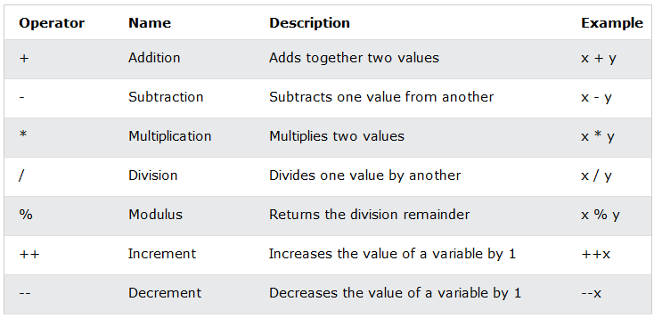
1. Arithmetic operators
Arithmetic operators are used to perform common mathematical operations.

Slide 6
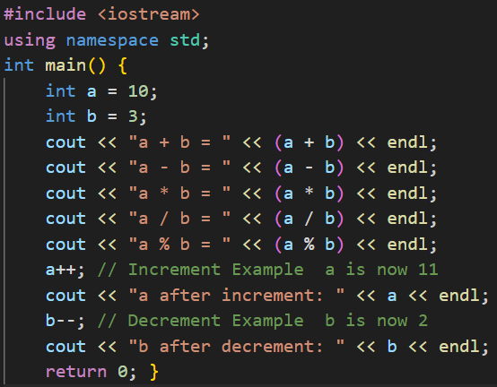
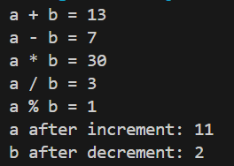
1. Arithmetic operators
#include <iostream>
using namespace std;
int main() {
int a = 10;
int b = 3;
cout << "a + b = " << (a + b) << endl;
cout << "a - b = " << (a - b) << endl;
cout << "a * b = " << (a * b) << endl;
cout << "a / b = " << (a / b) << endl;
cout << "a % b = " << (a % b) << endl;
a++; // Increment Example a is now 11
cout << "a after increment: " << a << endl;
b--; // Decrement Example b is now 2
cout << "b after decrement: " << b << endl;
return 0;
}

Slide 7
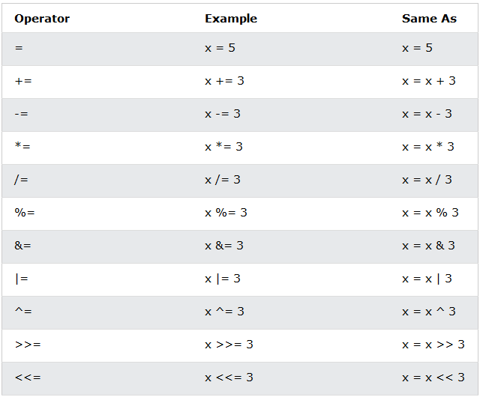
2. Assignment Operators
Assignment operators are used to assign values to variables.

Slide 8
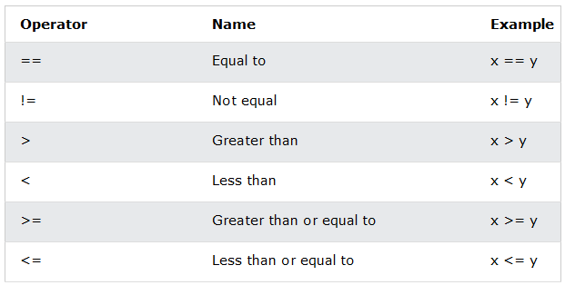
3. Comparison Operators
A list of all comparison operators:

Slide 9
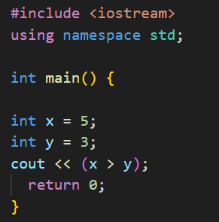
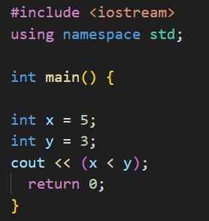

3. Comparison Operators
int x = 5;
int y = 3;
cout << (x > y); // returns 1 (true) because 5 is greater than 3

Slide 10
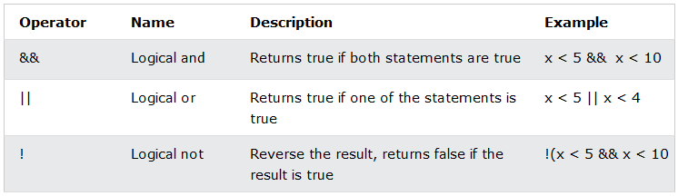
4. Logical Operators
Logical operators are used to determine the logic between variables or values.

Slide 11
5. C++ Math
Other functions, such as sqrt (square root), round (rounds a number) and log (natural logarithm), can be found in the <cmath> header file:
Function | Description
sqrt(x) | Returns the value of square root (x​).
pow(x, y) | Returns the value of x to the power of y
exp(x) | Returns the value of e raised to the power of x.
abs(x) | Returns the absolute value of x.
cbrt(x) | Returns the cube root of x.
ceil(x) | Returns the value of x rounded up to its nearest integer.
cos(x) | Returns the cosine of x.
sin(x) | Returns the sine of x.
acos(x) | Returns the arccosine (inverse cosine) of x.
asin(x) | Returns the arcsine (inverse sine) of x.
atan(x) | Returns the arctangent (inverse tangent) of x.
max(a,b) | Returns the value of the maximum between a and b

Slide 12
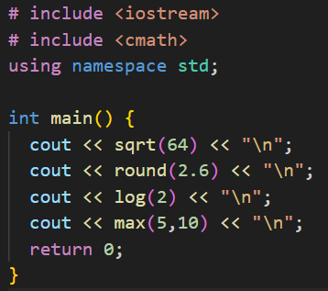
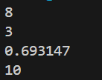
C++ <cmath> Header
# include <iostream>
# include <cmath>
using namespace std;
int main() {
cout << sqrt(64) << "\n";
cout << round(2.6) << "\n";
cout << log(2) << "\n";
cout << max(5,10) << "\n";
return 0;
}

Slide 13
6. C++ Booleans
It is very often, in programming, you will need a data type that can only have one of two values, like:
YES / NO
ON / OFF
TRUE / FALSE
For this, C++ has a bool data type, which can take the values true (1) or false (0).
Boolean Values
A boolean variable is declared with the bool keyword and can only take the values true or false:

Slide 14
Boolean Example
bool isCodingFun = true; bool isFishTasty = false; cout << isCodingFun; // Outputs 1 (true) cout << isFishTasty; // Outputs 0 (false)
From the example above, you can read that:
true value returns 1.
false value returns 0.
However, it is more common to return boolean values from boolean expressions.

Slide 15
Boolean Expression
A Boolean expression is a C++ expression that returns a boolean value: 1 (true) or 0 (false).
You can use a comparison operator, such as the greater than (>) operator to find out if an expression (or a variable) is true:
int x = 10; int y = 9; cout << (x > y); // returns 1 (true), because 10 is higher than 9
int x = 10; cout << (x == 10); // returns 1 (true), because the value of x is equal to 10

Slide 16
C++ Logical Operators
#include <iostream>
using namespace std;
int main() {
int x = 5;
int y = 3;
// returns false (0) because ! (not) is used to reverse the result
cout << (!(x > 3 && x < 10));
return 0;
}

Slide 17
Increment and Decrement Operators
Increment operator: increment variable by 1
Pre-increment: ++variable (prefix)
Post-increment: variable++ (postfix)
Decrement operator: decrement variable by 1
Pre-decrement: --variable
Post-decrement: variable --
Examples :
++K , K++ //k= K+1
--K , K-- //K= K-1

Slide 18
Increment and Decrement Operators
If the value produced by ++ or – – is not used in an expression, it does not matter whether it is a pre or a post increment (or decrement).
When ++ (or – –) is used before the variable name, the computer first increments (or decrements) the value of the variable and then uses its new value to evaluate the expression.
When ++ (or – –) is used after the variable name, the computer uses the current value of the variable to evaluate the expression, and then it increments (or decrements) the value of the variable.
There is a difference between the following :
x = 5;
Cout << ++x;
x = 5;
Cout << x++;

Slide 19
7. C++ Strings
Strings are used for storing text.
A string variable contains a collection of characters surrounded by double quotes. (i.e. “Hello“ )
To use strings, you must include an additional header file in the source code, the <string> library:
Example:
// Include the string library #include <string> // Create a string variable string greeting = "Hello";

Slide 20
String Concatenation
The + operator can be used between strings to add them together to make a new string. This is called concatenation.
Example:
string firstName = “Haitham ";
string lastName = “El-Ghareeb";
string fullName = firstName + lastName;
cout << fullName;
//add space using " " or ' '
string fullName = firstName + " " + lastName;
cout << fullName;

Slide 21
Append
you can also concatenate strings with the append() function:
string firstName = “Haitham ";
string lastName = “El-Ghareeb";
string fullName = firstName.append(lastName);
cout << fullName;

Slide 22
String Length
To get the length of a string, use the length() function:
string txt = "ABCDEFGHIJKLMNOPQRSTUVWXYZ";
cout << "The length of the txt string is: " << txt.length();
It is completely up to you if you want to use length() or size().

Slide 23
Access Strings
You can access the characters in a string by referring to its index number inside square brackets [ ].
string myString = "Hello";
cout << myString[0]; // Outputs H

Slide 24
Change String Characters
string myString = "Hello";
myString[0] = 'J';
cout << myString; // Outputs Jello instead of Hello

Slide 25
User Input Strings
It is possible to use the insertion operator >> on cin to get a string entered by a user:
string firstName;
cout << "Type your first name: ";
cin >> firstName; // get user input from the keyboard
cout << "Your name is: " << firstName;
// Type your first name: John
// Your name is: John

Slide 26



